Slide 1
DATA MINING LECTURE 1
Introduction

Slide 2
What is data mining?
After years of data mining there is still no unique answer to this question.
A tentative definition:
Data mining is the use of efficient techniques for the analysis of very large collections of data and the extraction of useful and possibly unexpected patterns in data.

Slide 3
Why do we need data mining?
Really, really huge amounts of raw data!!
In the digital age, TB of data is generated by the second.
Web, Wikipedia, Mobile devices, Digital photographs and videos, Facebook, Twitter, Instagram, Transactions, sensor data, behavioral data, scientific measurements, wearable computing
New ways of generating data are constantly created.
Cheap storage has made possible to maintain this data
Need to analyze the data to extract knowledge

Slide 4
Why do we need data mining?
“The data is the computer”
Large amounts of data can be more powerful than complex algorithms and models
Google has solved many Natural Language Processing problems, simply by looking at the data
Example: misspellings, synonyms
Data is power!
Today, the collected data is one of the biggest assets of an online company
Query logs of Google, The friendship and updates of Facebook, Tweets and follows of Twitter, Amazon transactions
Data for the people:
Using data from the people activity we can improve their individual lives but also the overall society life.
We need a way to harness the collective intelligence
From Data mining to Data Science

Slide 5
Example: transaction data
Billions of real-life customers:
WALMART: 20M transactions per day
AT&T 300 M calls per day
Credit card companies: billions of transactions per day.
Amazon: millions of purchases per day
The point cards allow companies to collect information about specific users

Slide 6
Example: document data
Web as a document repository: estimated 50 billions of web pages in Google index
Several trillions overall
Wikipedia: 4.9 million articles (and counting)
Online news portals: steady stream of 100’s of new articles every day
Twitter: ~500 million tweets every day

Slide 7
Example: network data
Web: 50 billion pages linked via hyperlinks
Facebook: 1.5 billion users
Twitter: 300 million users
LinkedIn: 300 million users

Slide 8
Example: genomic sequences
http://www.1000genomes.org/page.php
Full sequence of 1000 individuals
3 billion nucleotides per person → 3 trillion nucleotides
Lots more data in fact: medical history of the persons, gene expression data

Slide 9
Medical data
Wearable devices can measure your heart rate, blood sugar, blood pressure, and other signals about your health. Medical records are becoming available to individuals
Wearable computing
Brain imaging
Images that monitor the activity in different areas of the brain under different stimuli
TB of data that need to be analyzed.
Gene and Protein interaction networks
It is rare that a single gene regulates deterministically the expression of a condition.
There are complex networks and probabilistic models that govern the protein expression.

Slide 10
Example: environmental data
Climate data (just an example)
http://www.ncdc.gov/oa/climate/ghcn-monthly/index.php
“a database of temperature, precipitation and pressure records managed by the National Climatic Data Center, Arizona State University and the Carbon Dioxide Information Analysis Center”
“6000 temperature stations, 7500 precipitation stations, 2000 pressure stations”
Spatiotemporal data

Slide 11
Behavioral data
Mobile phones today record a large amount of information about the user behavior
GPS records position
Camera produces images
Communication via phone and SMS
Text via facebook updates
Association with entities via check-ins
Amazon collects all the items that you browsed, placed into your basket, read reviews about, purchased.
Google and Bing record all your browsing activity via toolbar plugins. They also record the queries you asked, the pages you saw and the clicks you did.
Data collected for millions of users on a daily basis

Slide 12
The data is also very complex
Multiple types of data: database tables, text, time series, images, videos, graphs, etc
Interconnected data of different types:
From the mobile phone we can collect, location of the user, friendship information, check-ins to venues, opinions through twitter, status updates in FB, images though cameras, queries to search engines
Spatial and temporal aspects

Slide 13
What can you do with the data?
Suppose that you are the owner of a supermarket and you have collected billions of market basket data. What information would you extract from it and how would you use it?
Product placement
Catalog creation

Slide 14
What can you do with the data?
In online sites such as Amazon, YouTube, Netflix the data collected can be at the individual level: we know for every user the items they have looked at, reviewed, selected.
What information can you get from this data?
Recommendations

Slide 15

Amazon Recommendations
“People who have bought this also bought…”
A huge breakthrough for amazon
Took advantage of the big tail
A big breakthrough for data mining in general

Slide 16
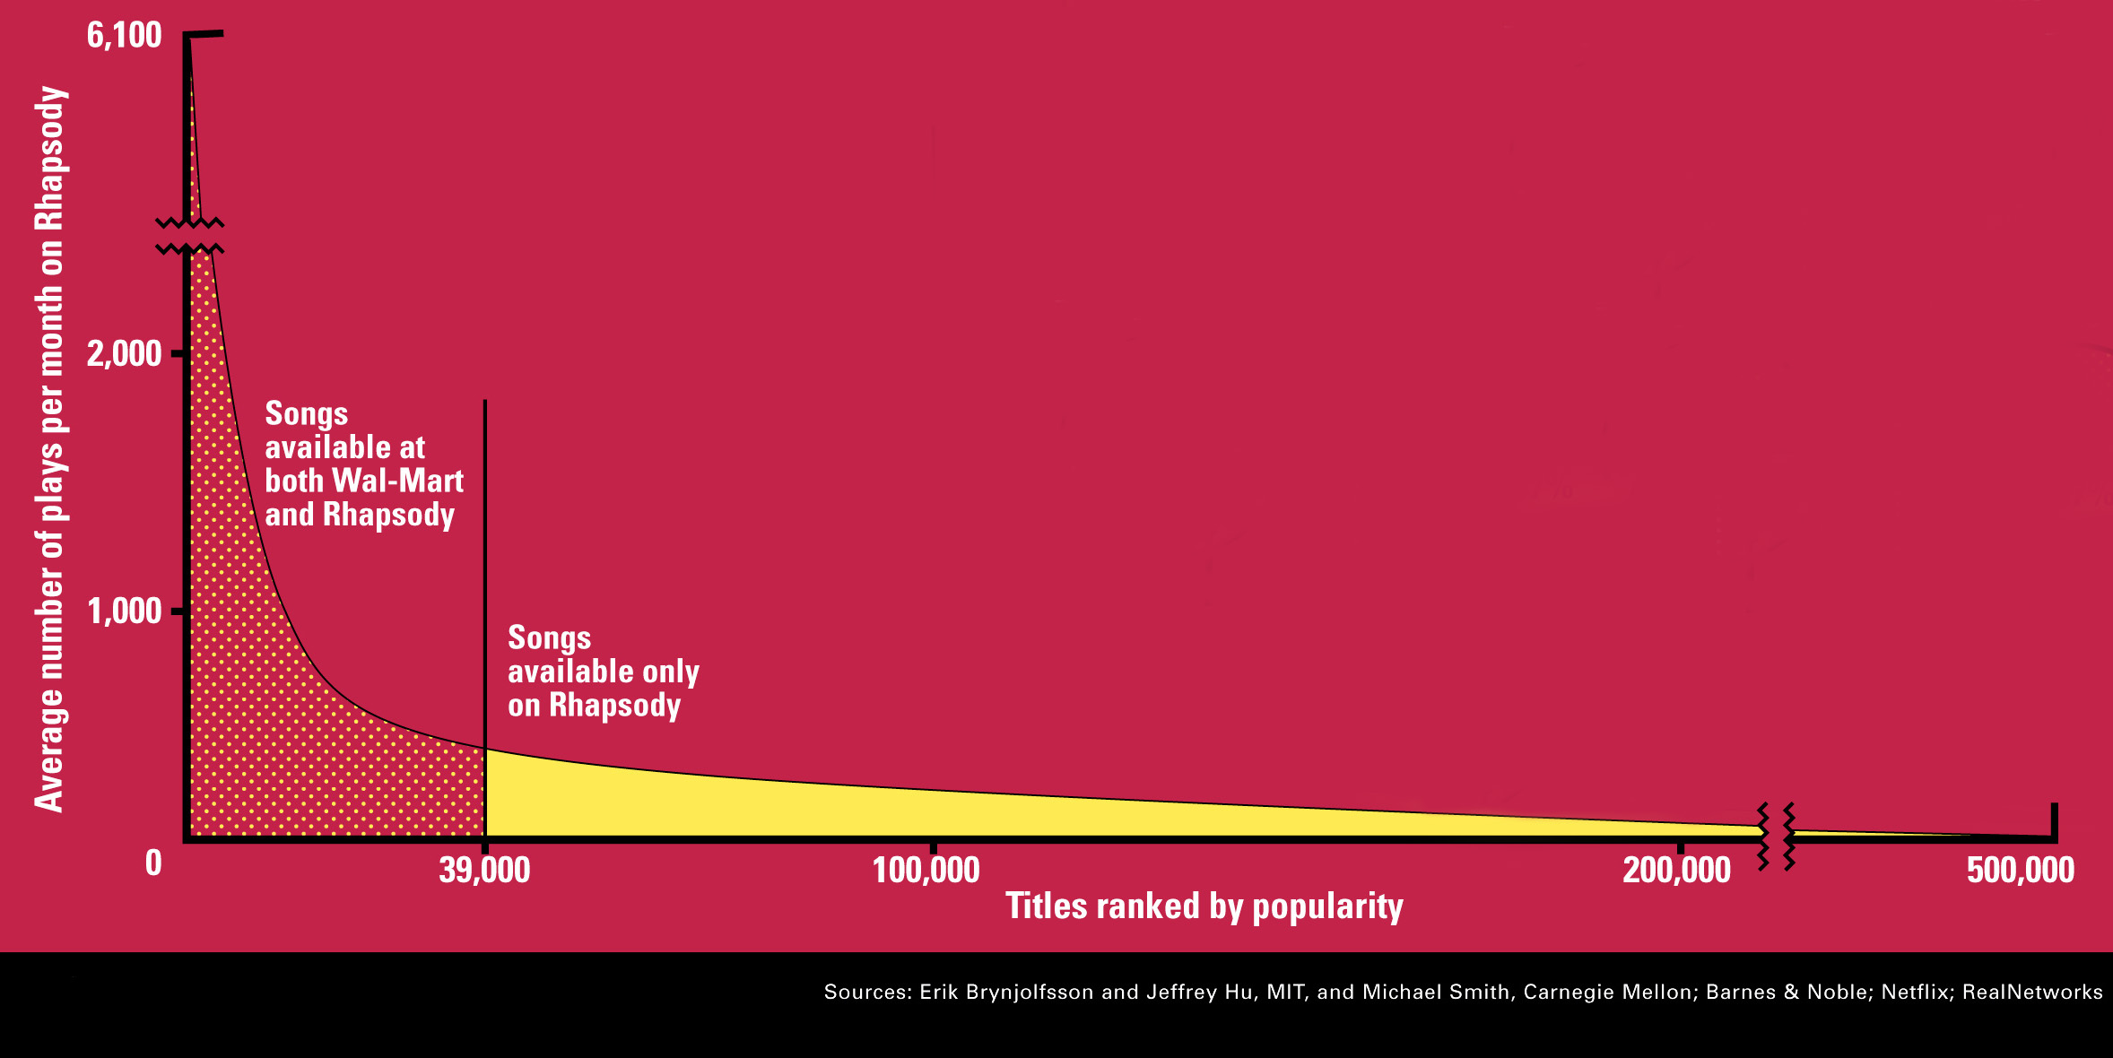
The Long Tail
Source: Chris Anderson (2004)

Slide 17
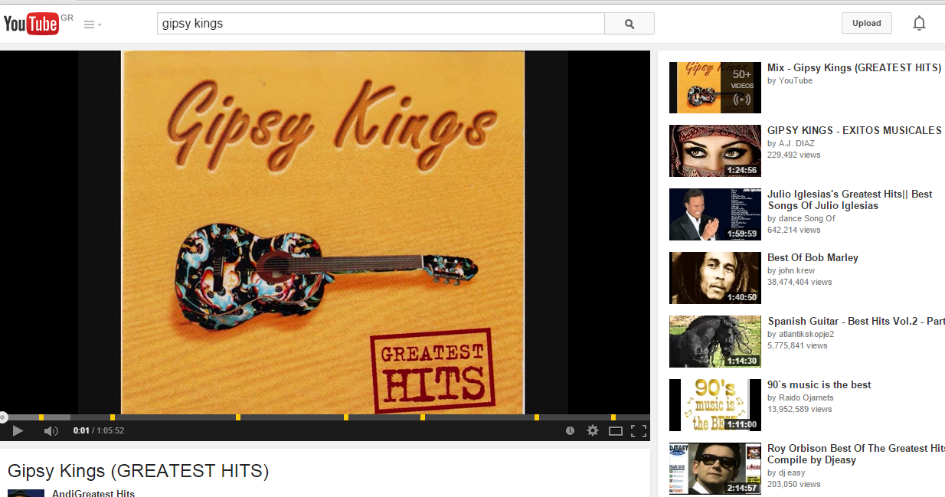
Other recommendation systems
Netflix, YouTube, Pandora, etc
Recommendation systems exploit the collective behavior of users to draw conclusions for an individual
Collaborative filtering

Slide 18
What can you do with the data?
Suppose you are a search engine and you have a toolbar log consisting of
pages browsed,
queries,
pages clicked,
ads clicked
each with a user id and a timestamp. What information would you like to get our of the data?
Ad click prediction
Query auto-completion and spelling correction

Slide 19
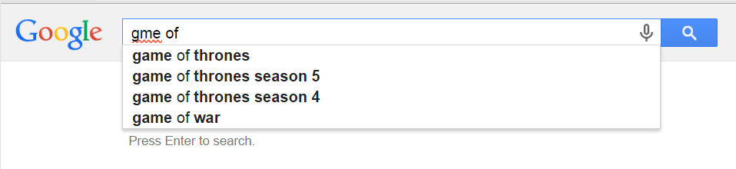
Example Application
Google auto-complete and spelling correction

Slide 20
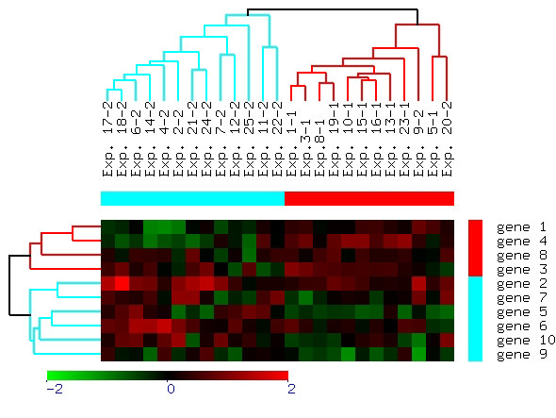
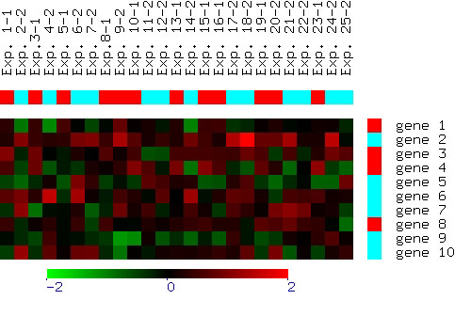
What can you do with the data?
Suppose you are biologist who has microarray expression data: thousands of genes, and their expression values over thousands of different settings (e.g. tissues). What information would you like to get out of your data?
Groups of genes and tissues

Slide 21
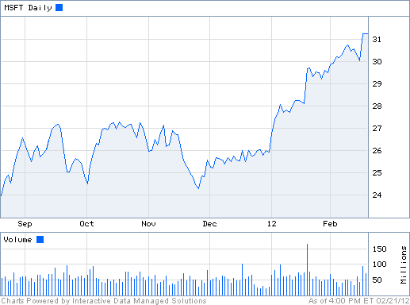
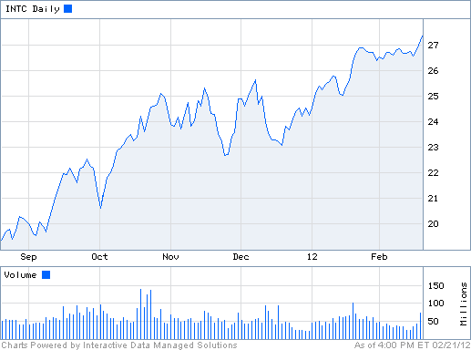
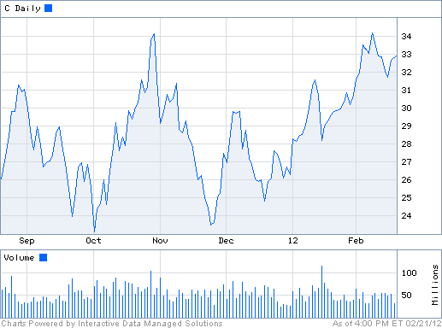
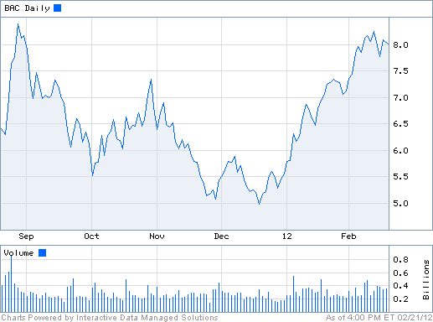
What can you do with the data?
Suppose you are a stock broker and you observe the fluctuations of multiple stocks over time. What information would you like to get our of your data?
Groups of similar stocks
Correlation of stocks
Stock Value prediction

Slide 22
What can you do with the data?
You are the owner of a social network, and you have full access to the social graph, what kind of information do you want to get out of your graph?
Who is the most important node in the graph?
What is the shortest path between two nodes?
How many friends two nodes have in common?
How does information spread in the network?
How likely are two nodes to become friends?

Slide 23
What is the most important node in this graph?

Slide 24
The Web as a graph
Application: When retrieving pages, the authoritativeness is factored in the ranking.
This is the idea that made Google a success around 2000
Today a lot more information is used, like clicks, browsing behavior, etc
Ranking of the pages is a very complex task that requires sophisticated techniques

Slide 25
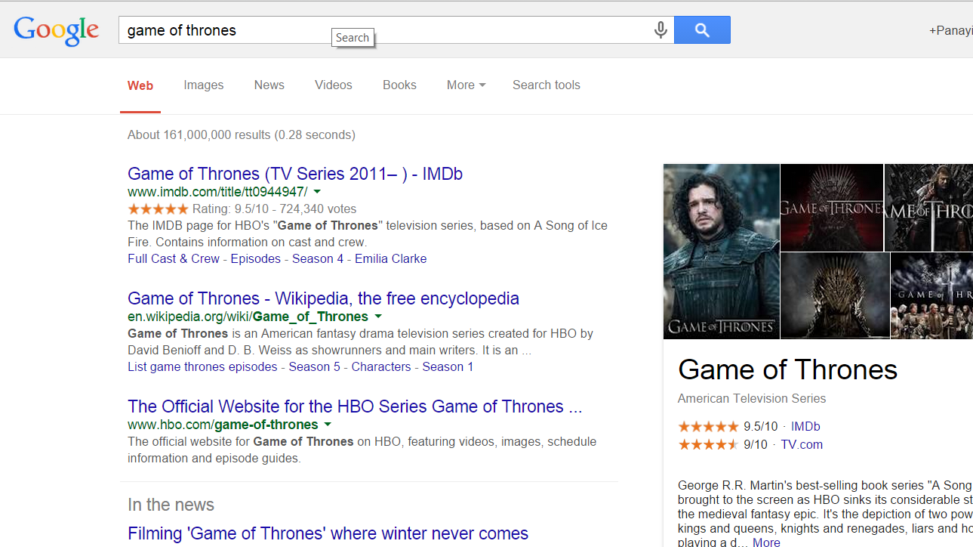

Slide 26
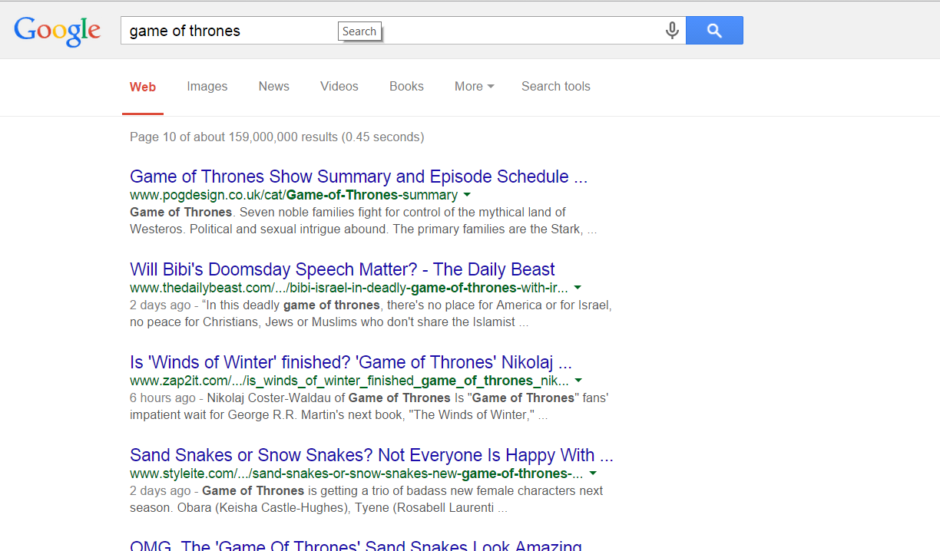

Slide 27
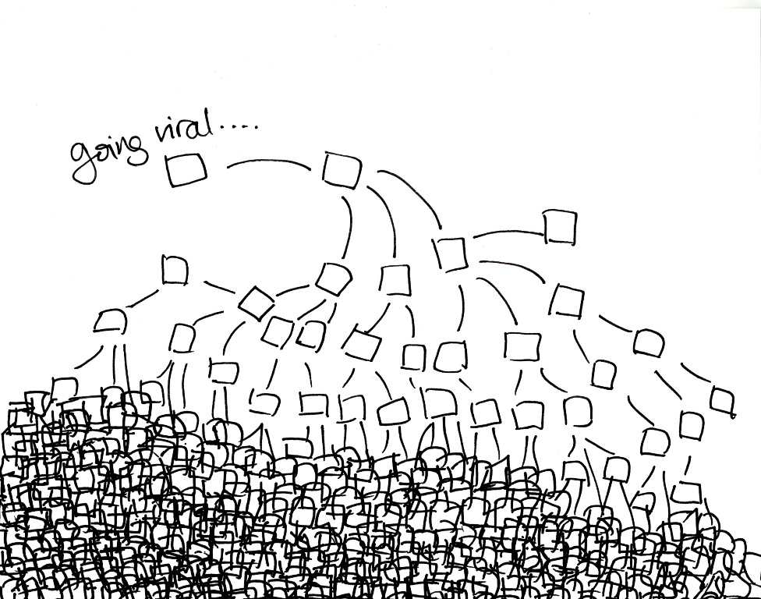
Viral Marketing
Word-of-Mouth marketing where the network of users do the advertising themselves.
It is considered the most effective, but also the hardest way to advertise
To which users should we advertise in order to maximize the spread of the message?

Slide 28



Friendship suggestions
LinkedIn, Twitter, Facebook friendship suggestions
Useful for the users to discover their friends, but also useful for the network in order to grow, and increase engagement
LinkedIn success story

Slide 29
Big data
The new trend in data mining…
An all-encompassing term to describe problems in science, industry, everyday life where there are huge amounts of data that need to be stored, maintained and analyzed to produce value.
The overall idea:
Every activity generates data
Wearable computing, Internet of Things, Brain Imaging, Urban behavior
If we collect and understand this data we can improve life for the individual and the world
E.g., Urban computing, Health informatics.
Deep Learning:
New techniques that can extract useful information (learn) from massive amounts of data.

Slide 30

Example: Big Data and Sports
All major soccer and basketball teams use data mining to make decisions.
The national team of Germany had a special software for the analysis of video.
They concluded that the possession time per player should be reduced.
Germany won the 2014 word cup

Slide 31

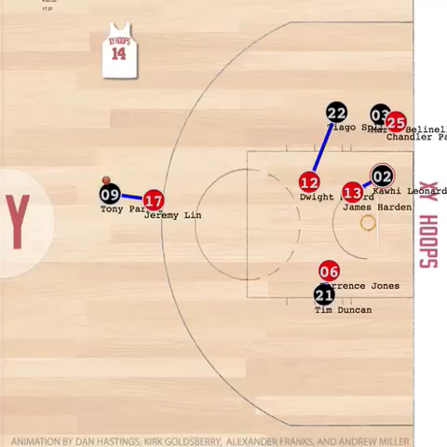
NBA and Data Mining
In NBA there are special conferences for data science

Slide 32
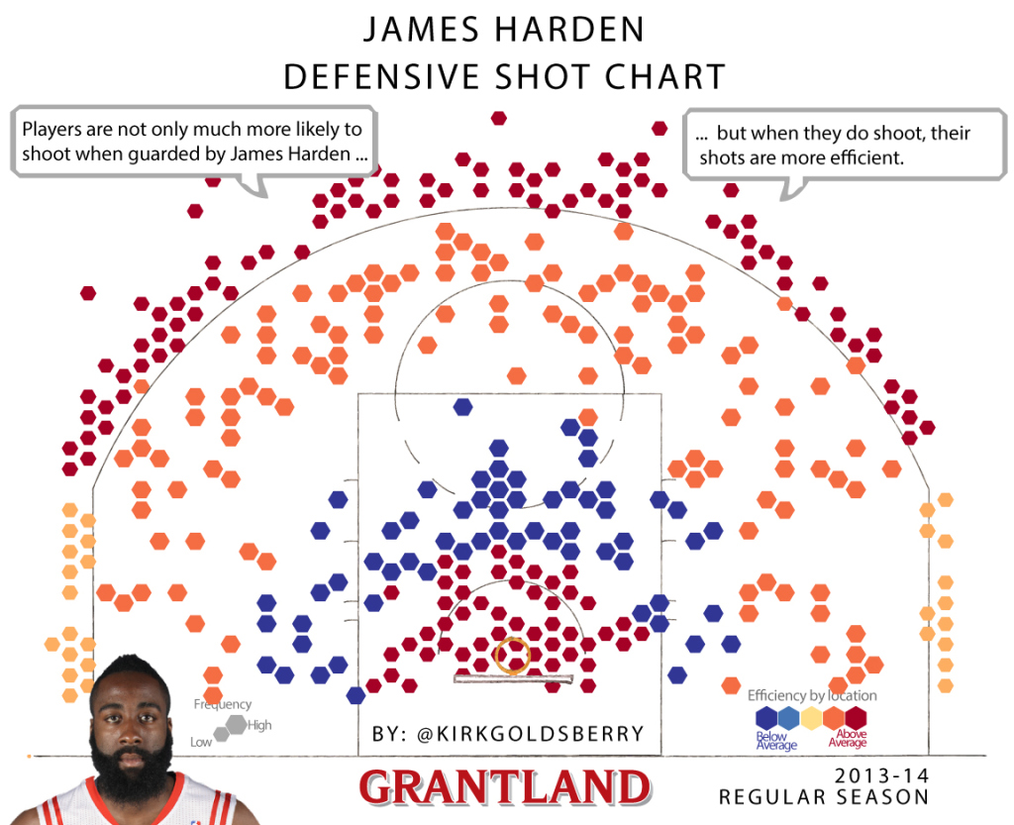
James Harden defence

Slide 33
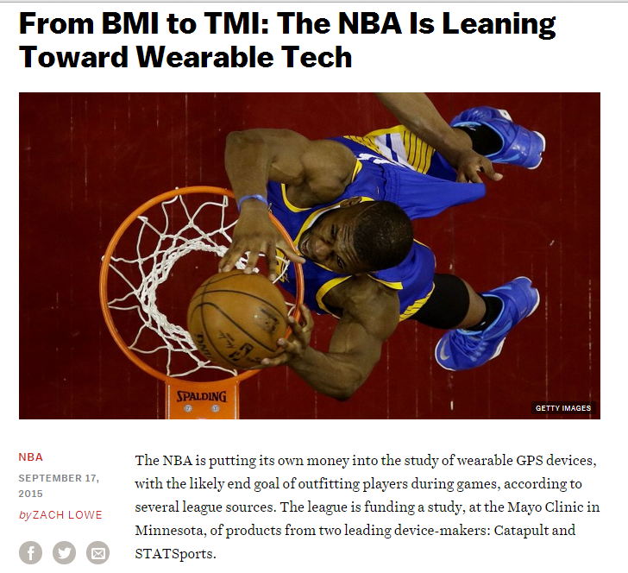

Slide 34
Why data mining?
Commercial point of view
Data has become the key competitive advantage of companies
Examples: Facebook, Google, Amazon
Being able to extract useful information out of the data is key for exploiting them commercially.
Scientific point of view
Scientists are at an unprecedented position where they can collect TB of information
Examples: Sensor data, astronomy data, social network data, gene data
We need the tools to analyze such data to get a better understanding of the world and advance science and help people
Scale (in data size and feature dimension)
Why not use traditional analytic methods?
Enormity of data, curse of dimensionality
The amount and the complexity of data does not allow for manual processing of the data. We need automated techniques.

Slide 35
What is Data Mining again?
“Data mining is the analysis of (often large) observational data sets to find unsuspected relationships and to summarize the data in novel ways that are both understandable and useful to the data analyst” (Hand, Mannila, Smyth)
“Data mining is the discovery of models for data” (Rajaraman, Ullman)
We can have the following types of models
Models that explain the data (e.g., a single function)
Models that predict the future data instances.
Models that summarize the data
Models the extract the most prominent features of the data.

Slide 36
What is data mining again?
The industry point of view: The analysis of huge amounts of data for extracting useful and actionable information, which is then integrated into production systems in the form of new features of products
Data Scientists should be good at data analysis, math, statistics, but also be able to code with huge amounts of data and use the extracted information to build products.

Slide 37
What can we do with data mining?
Some Data Mining topics:
Frequent itemsets and Association Rules extraction
Recommendation systems
Coverage
Clustering
Classification
Ranking
Exploratory analysis

Slide 38
Frequent Itemsets and Association Rules
Given a set of records each of which contain some number of items from a given collection;
Identify sets of items (itemsets) occurring frequently together
Produce dependency rules which will predict occurrence of an item based on occurrences of other items.
Challenge: Do this efficiently for millions of records and items
Itemsets Discovered:
{Milk,Coke}
{Diaper, Milk}
Rules Discovered:
{Milk} --> {Coke}
{Diaper, Milk} --> {Beer}
Tan, M. Steinbach and V. Kumar, Introduction to Data Mining

Slide 39
Example Application
Supermarket shelf management.
Goal: To identify items that are bought together by sufficiently many customers.
Approach: Process the point-of-sale data collected with barcode scanners to find dependencies among items.
A classic rule --
If a customer buys diaper and milk, then he is very likely to buy beer.
So, don’t be surprised if you find six-packs stacked next to diapers!
Tan, M. Steinbach and V. Kumar, Introduction to Data Mining

Slide 40
Frequent Itemsets: Applications
Text mining: finding associated phrases in text
There are lots of documents that contain the phrases “association rules”, “data mining” and “efficient algorithm”
Can be used to define key phrases, correct spelling mistakes, associate different concepts.
Recommendations:
Users who buy this item often buy this item as well
Users who watched James Bond movies, also watched Jason Bourne movies.
Recommendations make use of item and user similarity

Slide 41
Recommender systems
Collaborative filtering: Use the collective behavior of the users to draw conclusions for an individual
 | Harry Potter 1 | Harry Potter 2 | Harry Potter 3 | Twilight | Star Wars 1 | Star Wars 2 | Star Wars 3
A | 4 |  |  | 5 | 1
B | 5 | 5 | 4
C |  |  |  | 2 | 4 | 5
D |  | 3 |  |  |  |  | 3
Fill the empty entries of the matrix.
Use the fact that similar users will behave similarly
And similar items will be rated similarly
But how do we define similarity?
How do we make use of the collective behavior?
Big problem – Complicated math using probabilities/linear algerba

Slide 42
Clustering Definition
Given a set of data points, each having a set of attributes, and a similarity measure among them, find clusters such that
Data points in one cluster are more similar to one another.
Data points in separate clusters are less similar to one another.
Similarity Measures?
Euclidean Distance if attributes are continuous.
Other Problem-specific Measures.
Tan, M. Steinbach and V. Kumar, Introduction to Data Mining

Slide 43
Illustrating Clustering
Euclidean Distance Based Clustering in 3-D space.
Intracluster distances
are minimized
Intercluster distances
are maximized
Tan, M. Steinbach and V. Kumar, Introduction to Data Mining

Slide 44
Clustering: Application 1
Bioinformatics applications:
Goal: Group genes and tissues together such that genes are coexpressed on the same tissues

Slide 45
Clustering: Application 2
Document Clustering:
Goal: To find groups of documents that are similar to each other based on the important terms appearing in them.
Approach: To identify frequently occurring terms in each document. Form a similarity measure based on the frequencies of different terms. Use it to cluster.
Gain: Information Retrieval can utilize the clusters to relate a new document or search term to clustered documents.
Tan, M. Steinbach and V. Kumar, Introduction to Data Mining

Slide 46
Coverage
Given a set of customers and items and the transaction relationship between the two, select a small set of items that “covers” all users.
For each user there is at least one item in the set that the user has bought.
Application:
Create a catalog to send out that has at least one item of interest for every customer.

Slide 47
Classification: Definition
Given a collection of records (training set )
Each record contains a set of attributes, one of the attributes is the class.
Find a model for class attribute as a function of the values of other attributes.
Goal: previously unseen records should be assigned a class as accurately as possible.
In simple terms: Create a model that predicts a specific property of the data

Slide 48
Classification Example: Tax Fraud
categorical
categorical
continuous
class
Test
Set
Learn
Classifier
Training
Set
Model
Tan, M. Steinbach and V. Kumar, Introduction to Data Mining

Slide 49
Model Example: Decision Trees
Refund
Yes
No
NO
MarSt
Single, Divorced
Married
TaxInc
NO
< 80K
> 80K
NO
YES

Slide 50
Classification: Application 1
Ad Click Prediction
Goal: Predict if a user that visits a web page will click on a displayed ad. Use it to target users with high click probability.
Approach:
Collect data for users over a period of time and record who clicks and who does not. The {click, no click} information forms the class attribute.
Use the history of the user (web pages browsed, queries issued) as the features.
Learn a classifier model and test on new users.

Slide 51
Classification: Application 2
Fraud Detection
Goal: Predict fraudulent cases in credit card transactions.
Approach:
Use credit card transactions and the information on its account-holder as attributes.
When does a customer buy, what does he buy, how often he pays on time, etc
Label past transactions as fraud or fair transactions. This forms the class attribute.
Learn a model for the class of the transactions.
Use this model to detect fraud by observing credit card transactions on an account.
Tan, M. Steinbach and V. Kumar, Introduction to Data Mining

Slide 52
Network data analysis
Link Analysis Ranking: Given a collection of web pages that are linked to each other, rank the pages according to importance (authoritativeness) in the graph
Intuition: A page gains authority if it is linked to by another authoritative page.

Slide 53
The PageRank algorithm
Think of the nodes in the graph as containers of capacity of 1 liter.
We distribute a liter of liquid equally to all containers

Slide 54
The PageRank algorithm
The edges act like pipes that transfer liquid between nodes.

Slide 55
The PageRank algorithm
The edges act like pipes that transfer liquid between nodes.
The contents of each node are distributed to its neighbors.

Slide 56
The PageRank algorithm
The edges act like pipes that transfer liquid between nodes.
The contents of each node are distributed to its neighbors.

Slide 57
The PageRank algorithm
The edges act like pipes that transfer liquid between nodes.
The contents of each node are distributed to its neighbors.

Slide 58
The PageRank algorithm
The system will reach an equilibrium state where the amount of liquid in each node remains constant.

Slide 59
The PageRank algorithm
The amount of liquid in each node determines the importance of the node.
Large quantity means large incoming flow from nodes with large quantity of liquid.
Mathematically, we compute an eigenvector of a matrix defined by the adjacency matrix of the graph

Slide 60
Network data analysis
Given a social network can you predict which individuals will connect in the future?
Triadic closure principle: Links are created in a way that usually closes a triangle
If both Bob and Charlie know Alice, then they are likely to meet at some point.
Application: Friend/Connection suggestions in social networks

Slide 61
Exploratory Analysis
Trying to understand the data as a physical phenomenon, and describe them with simple metrics
What does the web graph look like?
How often do people repeat the same query?
Are friends in facebook also friends in twitter?
The important thing is to find the right metrics and ask the right questions
It helps our understanding of the world, and can lead to models of the phenomena we observe.

Slide 62
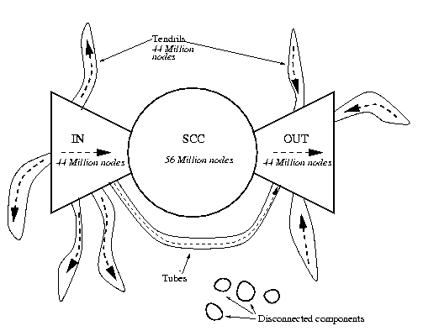
Exploratory Analysis: The Web
What is the structure and the properties of the web?

Slide 63
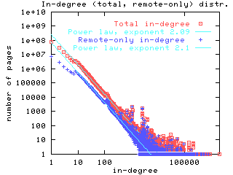
Exploratory Analysis: The Web
What is the distribution of the incoming links?

Slide 64
Connections of Data Mining with other areas
Draws ideas from machine learning/AI, pattern recognition, statistics, and database systems
Traditional Techniques may be unsuitable due to
Enormity of data
High dimensionality of data
Heterogeneous, distributed nature of data
Emphasis on the use of data
Statistics/ AI
Machine Learning/
Pattern Recognition
Data Mining
Database systems
Tan, M. Steinbach and V. Kumar, Introduction to Data Mining

Slide 65
Cultures
Databases: concentrate on large-scale (non-main-memory) data.
AI (machine-learning): concentrate on complex methods, small data.
In today’s world data is more important than algorithms
Statistics: concentrate on models.
Big Data: Make machine learning scale on large data
CS345A Data Mining on the Web: Anand Rajaraman, Jeff Ullman

Slide 66
Models vs. Analytic Processing
To a database person, data-mining is an extreme form of analytic processing – queries that examine large amounts of data.
Result is the query answer.
To a statistician, data-mining is the inference of models.
Result is the parameters of the model.
CS345A Data Mining on the Web: Anand Rajaraman, Jeff Ullman

Slide 67
New era of data mining
Boundaries are becoming less clear
Today data mining and machine learning are synonymous. It is assumed that there algorithms should scale. It is clear that statistical inference is used for building the models.

Slide 68
Data Mining: Confluence of Multiple Disciplines
Database
Technology
Statistics
Machine
Learning
Data Mining
Visualization
Pattern
Recognition
Other
Disciplines
Algorithms

Slide 69
Data Mining: Confluence of Multiple Disciplines
Database
Technology
Statistics
Machine
Learning
Data Mining
Visualization
Pattern
Recognition
Other
Disciplines
Algorithms

Slide 70
Data Mining: Confluence of Multiple Disciplines
Database
Technology
Statistics
Machine
Learning
Data Mining
Visualization
Pattern
Recognition
Distributed
Computing
Algorithms

Slide 71
Single-node architecture
CPU
Machine Learning, Statistics
Memory
“Classical” Data Mining
Disk

Slide 72
Commodity Clusters
Web data sets can be very large
Tens to hundreds of terabytes
Cannot mine on a single server
Standard architecture emerging:
Cluster of commodity Linux nodes, Gigabit ethernet interconnect
Google GFS; Hadoop HDFS; Kosmix KFS
Typical usage pattern
Huge files (100s of GB to TB)
Data is rarely updated in place
Reads and appends are common
How to organize computations on this architecture?
Map-Reduce paradigm

Slide 73
Cluster Architecture
2-10 Gbps backbone between racks
1 Gbps between
any pair of nodes
in a rack
Switch
Switch
Switch
CPU
CPU
CPU
CPU
Mem
…
Mem
Mem
…
Mem
Disk
Disk
Disk
Disk
Each rack contains 16-64 nodes

Slide 74
Map-Reduce paradigm
Map the data into key-value pairs
E.g., map a document to word-count pairs
Group by key
Group all pairs of the same word, with lists of counts
Reduce by aggregating
E.g. sum all the counts to produce the total count.

Slide 75
Putting it all together: The LinkedIn Data Mining Pipeline
Data Pipeline
Model Fitting Pipeline (Hadoop)
feature extraction
feature transformation
user modeling
offline modeling fitting
(cold-start model)
nearline modeling fitting
(warm-start model)
daily/weekly
minutes/hourly
Online Serving System
data tracking & logging
multi-pass rankers
candidates generation
real-time feedback
online A/B test
model evaluation

Slide 76
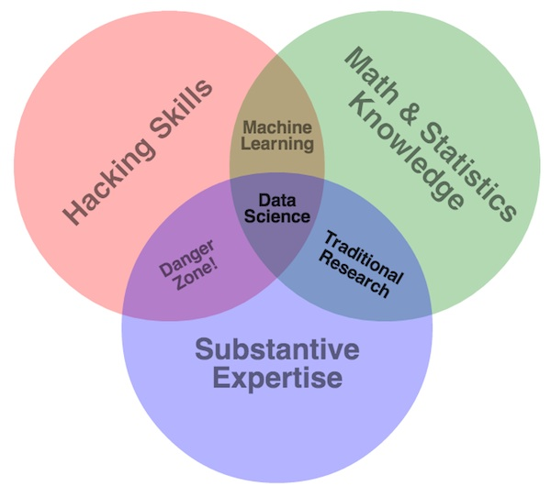
The Skills of a Data Miner – Data Scientist
It is a hard job

Slide 77
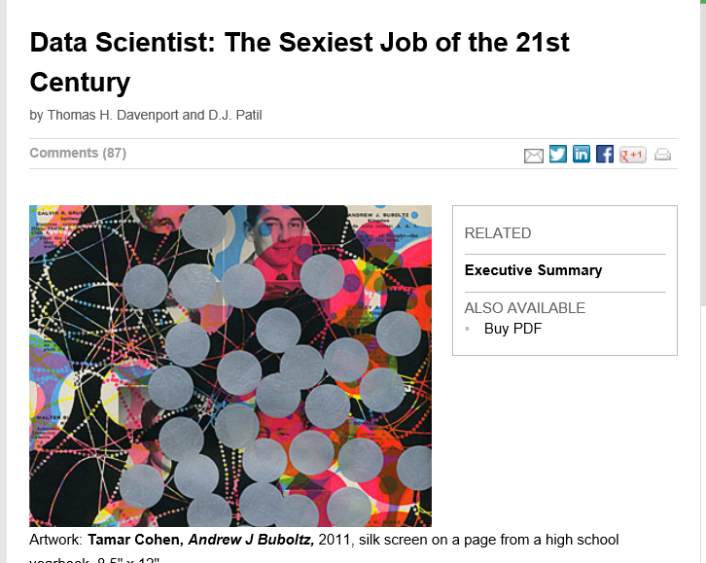
But also a rewarding one
"The success of companies like Google, Facebook, Amazon, and Netflix, not to mention Wall Street firms and industries from manufacturing and retail to healthcare, is increasingly driven by better tools for extracting meaning from very large quantities of data. 'Data Scientist' is now the hottest job title in Silicon Valley." – Tim O'Reilly

